Slide 1
caCORE SDK
caBIG Developer Boot Camp
Satish Patel

Slide 2
Session Goals
By the end of this session, you will be able to:
Use the caCORE Software Development Kit (SDK) to generate code for an application or service

Slide 3
Agenda
SDK requirements
Data service basics
What is caCORE SDK
Data service creation with SDK
Running the SDK code generator
Demonstration

Slide 4
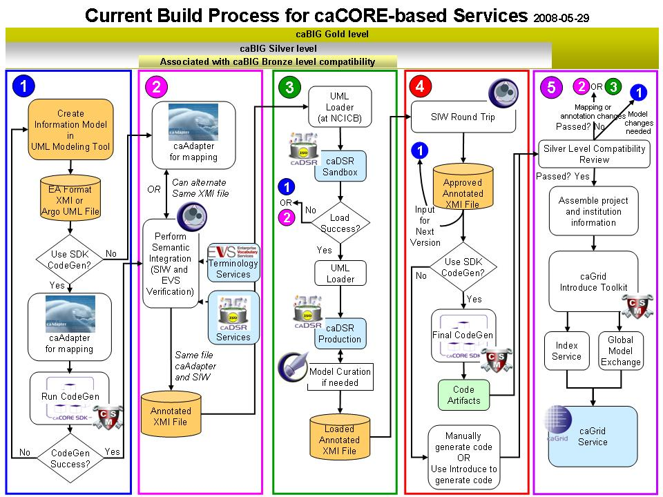
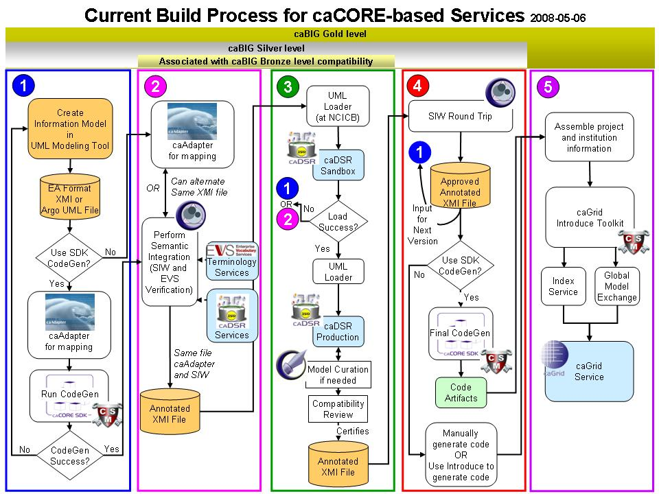
Metadata Reuse
Create UML Model
Semantic Annotation
Transform UML Model into Metadata
SDK Code Generation
Compatibility Review
Create a Node on the Grid

Slide 5
What is Required to Use SDK
Must have working knowledge of
  UML class diagrams
  Enterprise Architect or ArgoUML
  Java
Nice to have knowledge about
  Hibernate
  Web applications
  XML

Slide 6
Required Software
Enterprise Architect (version 6.5+) or ArgoUML
Java Development Kit - JDK (version 1.5 or above)
JBoss (version 4.0.5) or Apache Tomcat (version 5.5.19)
Apache Ant version (version 1.6.5+)
Internet Explorer (version 5.5 or above)
and caCORE SDK Code Generator

Slide 7

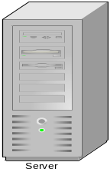
Data Service – What Is It?
A service that allows data owners to share the data from source like relational database (e.g. oracle or mysql) with their collaborators
caCORE SDK Generated System
OR
Custom Built Application
Human readable interface (GUI)
Database
Machine readable interface (Java API / Webservice)

Slide 8
What is caCORE SDK?
Framework to generate a Data Services
  Simple tool to build applications for collaborative research environment
  Enables users to quickly build the APIs from UML Model
  Syntactically interoperable APIs (Query via information model)
Integrated security
Built using open source tools and technologies
Seamless integration with cagrid tools

Slide 9
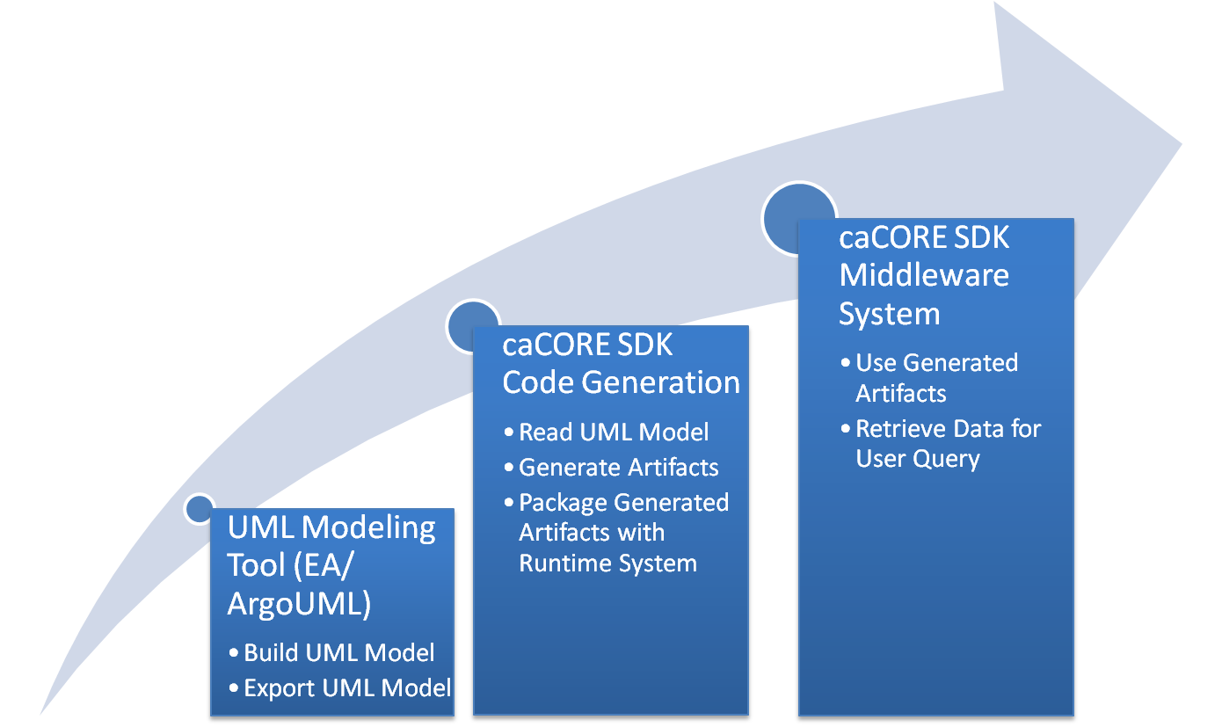
SDK System Generation Process

Slide 10
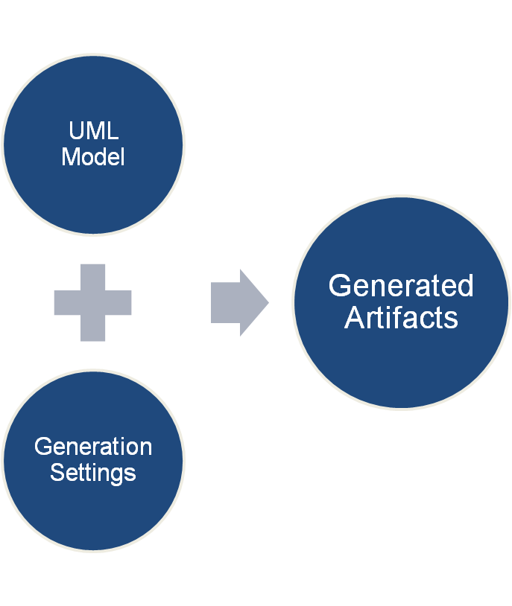
Generated Artifacts from UML
Java beans
Hibernate mapping files
EhCache configuration file
XSD
Castor mapping files
WSDD file
Other configuration files

Slide 11
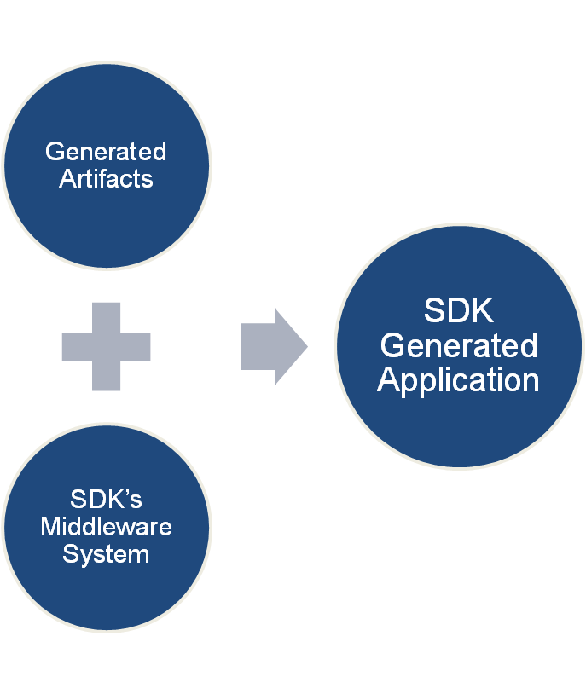
SDK Generated System
Web Application
RESTful Interface
Remote Client
Web Service Interface
Local Client

Slide 12










Generated System
Core Services
Registered in
Registered in
Semantically described with terminology from
Object
Definition
WSDL
XSD
Map to
Service Definition
Validate against
SDK Service
Generated by Introduce
SDK Service API
SDK Client API
Grid Service
Grid Client API
Client App
Oracle
Database
Objects
Java API
Reads
XML
Objects
MySQL
Database
Objects
Java API
Reads
Objects
Client uses
Service Definition
WSDL
XSD
Validate against
Web Service
Client uses
CSM
Security
Database
XML
Checks
Internet Browser
HTTP/REST
XML/ HTML

Slide 13
SDK 4.1 Features
Writable API
  Supports full array of CRUD operations
  Inbuilt validator to validate the data before insert/update
  Support for specifying the primary key generators, cascade settings etc at the UML model level
Integrated logging and auditing with CLM
  Keeps the trail of changes made in the database
  Provides a web based application to view the audit trail
Support for additional ways to perform O/R mapping
  Implicit inheritance
  Abstract classes
  Marker interfaces
Performance enhancements for Query By Example

Slide 14
SDK Roadmap
Freestyle search API
  Ability to specify the search index fields in the UML model
  Provide search engine like functionality on the user’s database
Graphical Installer
  Perform the system generation and deployment from a GUI
  User friendly interface to input the settings in correct fashion
Support for HL7 data types
  Ability to specify HL7 data types in the UML model instead of Java types

Slide 15
RUNNING THE CODE GENERATOR

Slide 16
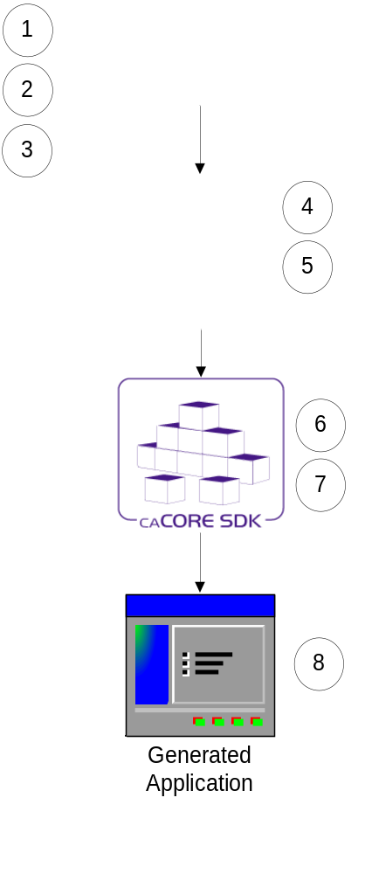
Running the Code Generator
Create Object Model (EA/ArgoUML)
Create Data Model (EA/ArgoUML)
Export the model in XMI format
Perform Object to Table mapping (caAdapter)
Perform Attribute to Column mapping (caAdapter)
Configure the code generator
Run the code generator
Running the generated system
Assumption: Database is already configured and tables are populated with data
Note: Steps 4 & 5 can be performed in EA/ArgoUML without using caAdapter.

Slide 17
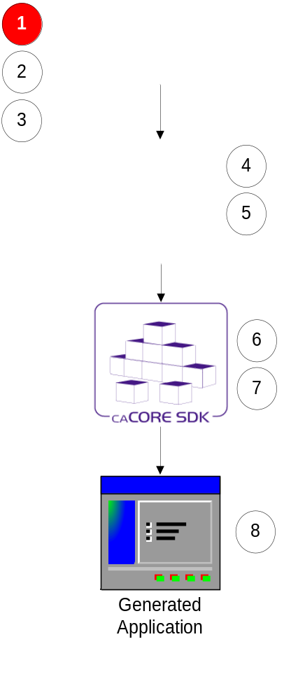
Step 1:
Creating Object Model (Enterprise Architect)
Define classes and its attributes
Define associations between classes
Note: Always follow naming conventions mentioned in the programmer’s guide

Slide 18
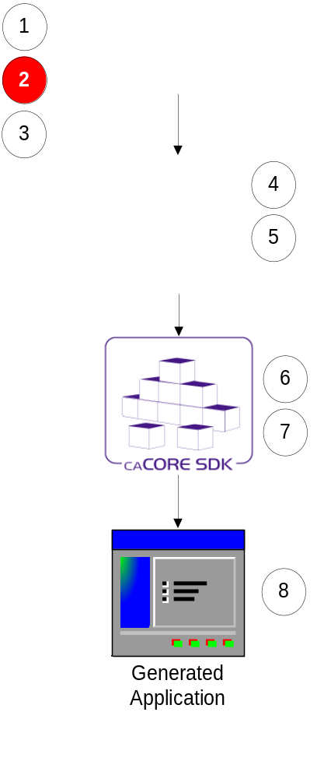
Step 2:
Creating Data Model (Enterprise Architect)
Define tables and its columns
Define primary key and foreign key constraints

Slide 19
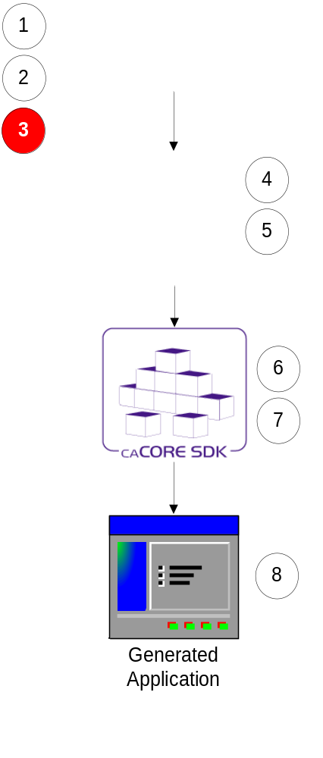
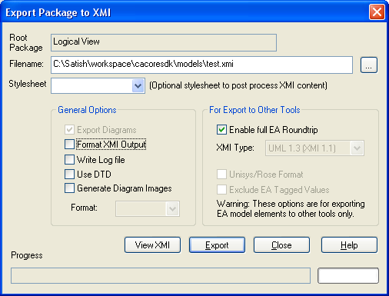
Step 3:
Export the UML Model
Export the UML model in XMI format

Slide 20
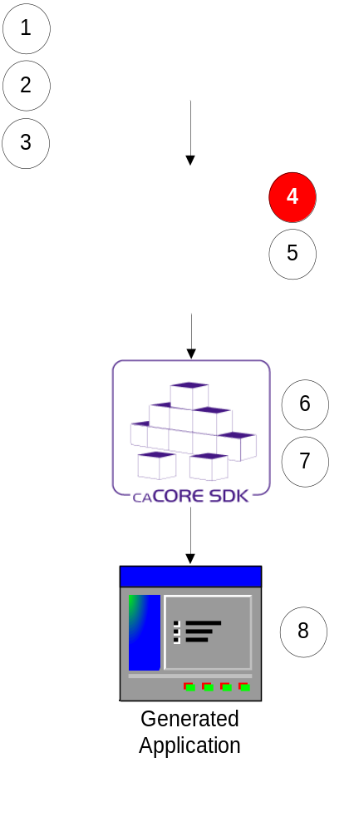
Step 4: Perform Class to Table Mapping
(caAdapter or Enterprise Architect)
Create Dependency link between a Class and a Table
i.e. drag class and drop it on table

Slide 21
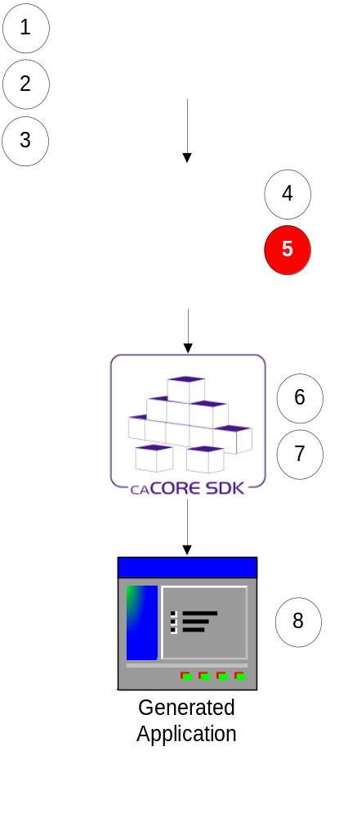
Step 5: Perform Attribute to Column Mapping
(caAdapter or Enterprise Architect)
Create link between a class attribute and table column using a Tag Value
i.e. drag attribute and drop it on column and drag association and drop it on foreign key column

Slide 22
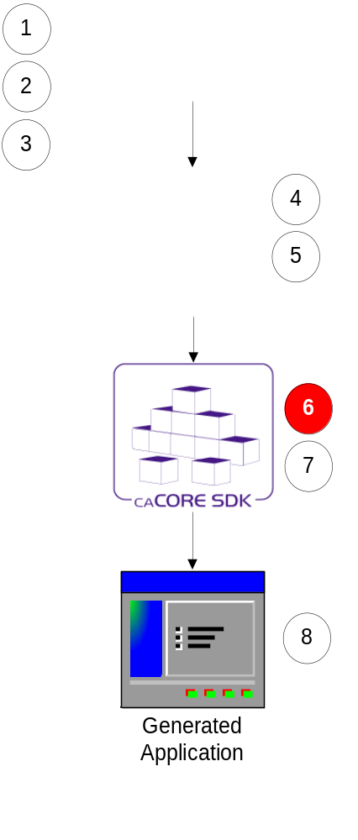
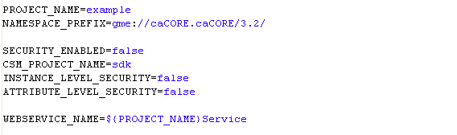
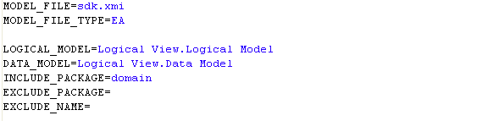
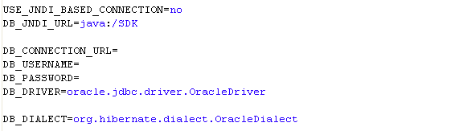
Step 6:
Configure Code Generator
Configuration defined in deploy.properties

Slide 23
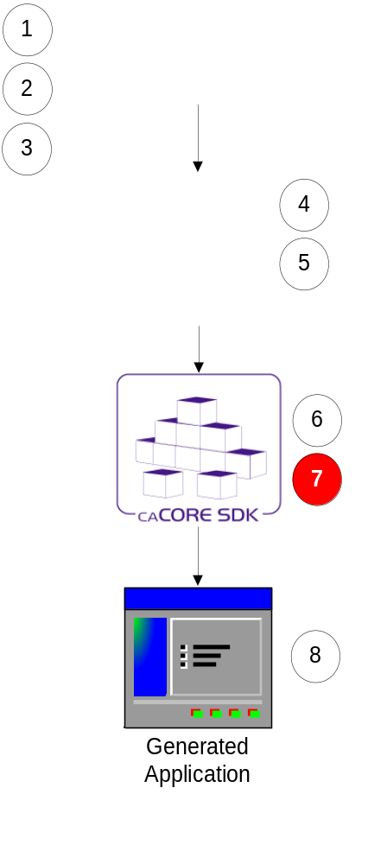
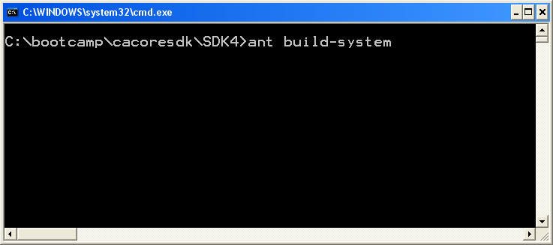
Step 7:
Run Code Generator
Put exported XMI file in caCORE SDK’s models directory
Go to command window
Execute build-system target

Slide 24
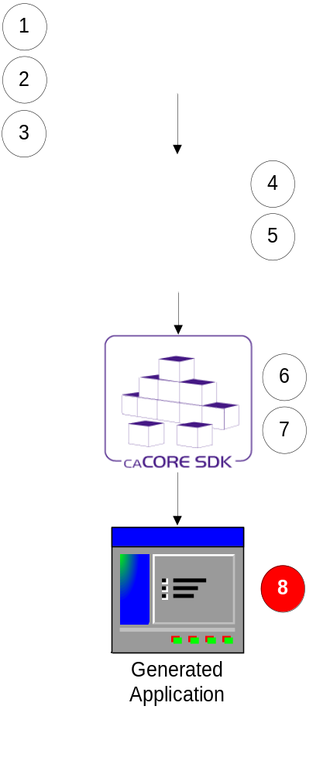
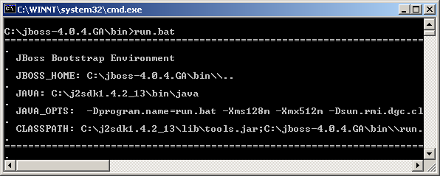
Step 8:
Running Generated System
Copy generated application to the server
Start the application server

Slide 25
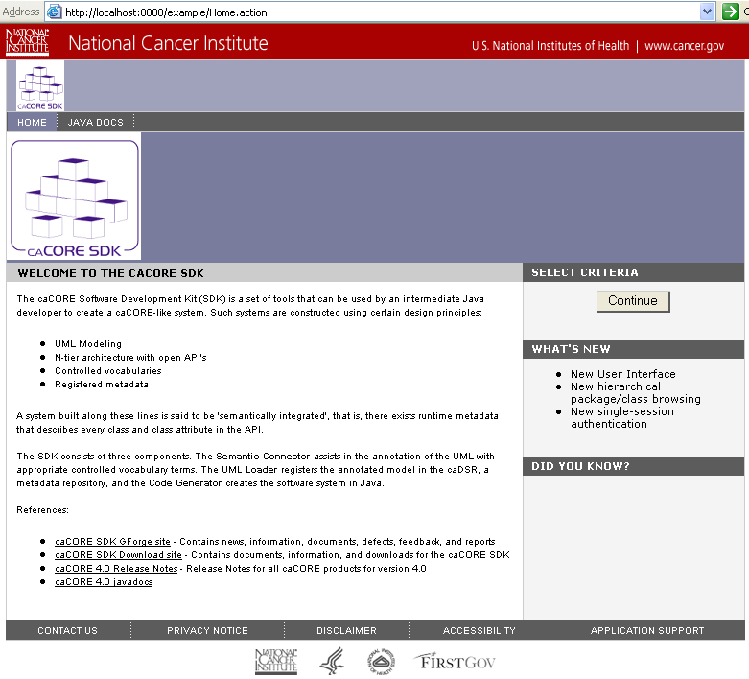
SDK Generated System – HTTP Interface

Slide 26
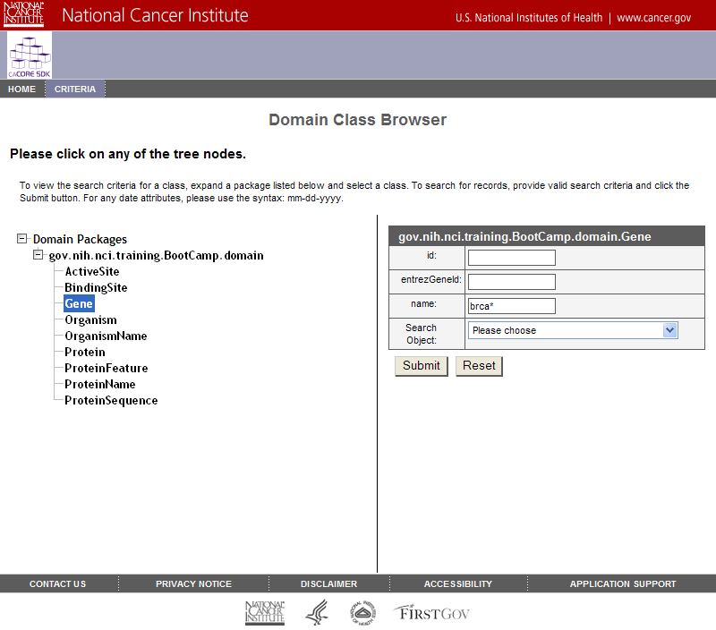
SDK Generated System – HTTP Interface

Slide 27
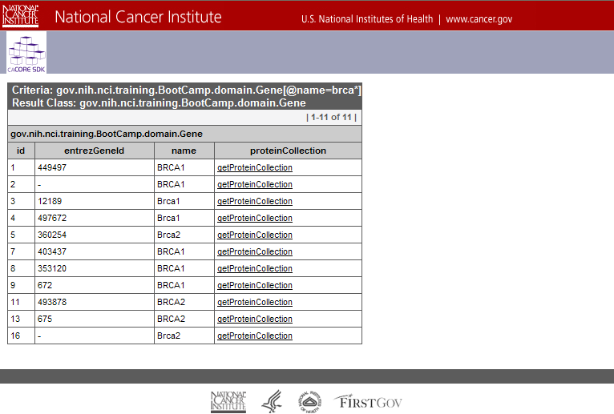
SDK Generated System – HTTP Interface

Slide 28
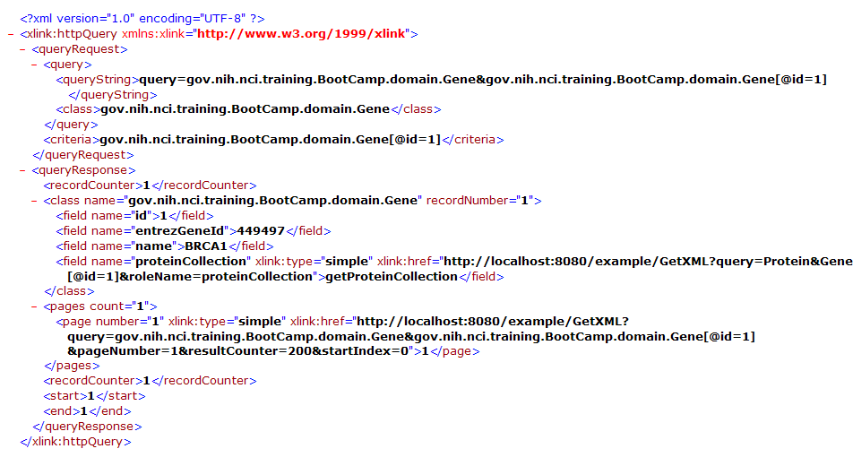
SDK Generated System – XML Interface

Slide 29
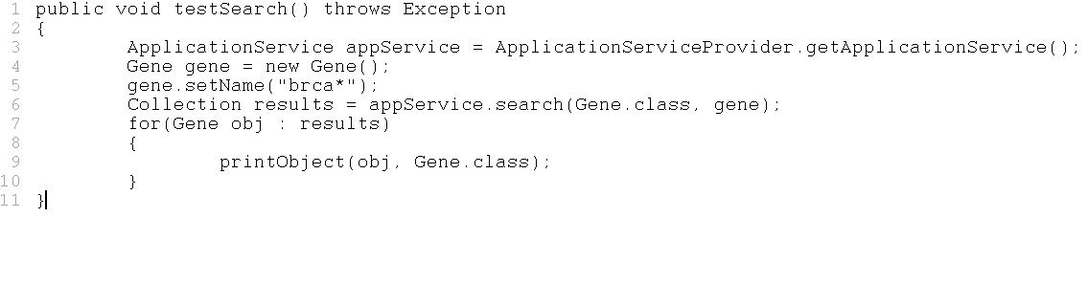
SDK Generated System – Java API

Slide 30
Demonstration (Example Model)
Open command window
Start → Run → cmd
Go to SDK’s home directory
cd c:\bootcamp\cacoresdk\SDK4
Run code generator
ant build-system
Deploy generated system
cd output\example\package\webapp\
copy example.war c:\bootcamp\cacoresdk\jboss\server\default\deploy
Start application server
c:\bootcamp\cacoresdk\jboss\bin\run.bat
Test user interface
http://localhost:8080/example
Test Java API client
cd c:\cacoresdk\SDK4\output\example\package\remote-client
ant run

Slide 31
Questions ???
SDK Users Mailing List
cacore_sdk_users-L@list.nih.gov

